Slide 1

Compare and Contrast
What reigns supreme!

Slide 2
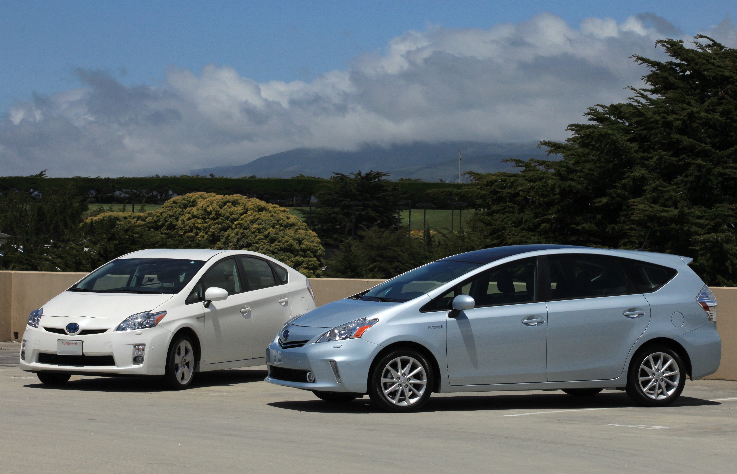
Welcome
Have you ever faced this kind of decision?

Slide 3
What you will need
Pen and paper for notes
A copy of a Venn Diagram (on D2L)
An open mind

Slide 4
What is a compare and Contrast Essay
An essay where were alternatives are set in opposition in order to reveal similarities and differences.
In other words, what's a way to figure out what is the same and what's different. Analyze.
Decision upcoming

Slide 5

Beware
It’s not that simple
Surface level and deeper level
Don’t be basic
Answer why!!!

Slide 6
Car vs Car

Slide 7
the essay
Audience
Purpose
Thesis!!!
  It states the decision
  Located in the intro paragraph (usually it’s the last sentence)
  Sets up the rest of the essay
  Without a thesis, there is no essay. Period.

Slide 8
Thesis
Take the other point into account
Declares a winner
Says why
Example: Despite both cars being similar, the blue car is the best choice because it gets better gas mileage, the car payments are affordable, and it has fewer miles.

Slide 9
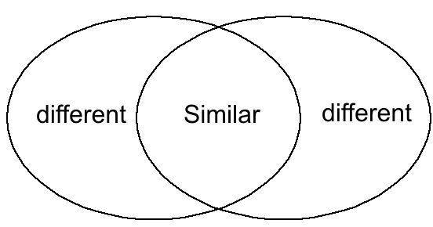
How to make an “A” on this essay
Don't go for the obvious similarities or differences.
The better the brainstorming the better the grade. (Venn Diagram)
Structure, structure, structure!

Slide 10
brainstorming
Strength of brainstorming helps with the essay
Venn Diagram or a chart is helpful
Explain your similarities and differences.

Slide 11
Activity: whatburger vs mcdonald’s
Go to D2L and download the Venn Diagram.
Brainstorm the following: You’re on the road and you’re hungry. It’s 6 p.m. and you haven’t eaten since breakfast – a bagel and a juice. There’s only two choices. There’s a McDonald’s that’s only five minutes away and a Whataburger that’s 15 minutes away. What do you decide and why?
Use the Venn Diagram to help you decide. Fill it with as many similarities and differences. Don’t go for the easiest explanations.
Bring the filled diagram to class next time.

Slide 12
Structure one – One side at a time
White car
  Gas mileage
  Car payments
  Miles
Blue car
  Gas mileage
  Car payments
  Miles
Subject A
  Point 1
  Point 2
  Point 3
Subject B
  Point 1
  Point 2
  Point 3

Slide 13
Structure two – point by point
Gas mileage
  Blue car
  White car
Car Payments
  Blue car
  White car
Miles
  Blue car
  White car
Subject A, point 1
Subject B, point 1
Subject A, point 2
Subject B, point 2
Subject A, point 3
Subject B, point 3

Slide 14
Structure three - combo
White car
  Gas mileage
  Car Payment
  Miles
Blue car
  Gas mileage
  Car Payment
  Miles
White car
  Warranty
Blue Car
  Warranty
Subject A
  Point 1
  Point 2
  Point 3
Subject B
  Point 1
  Point 2
  Point 3
Subject A
  point 4
Subject B,
  point 4.

Slide 15

Some other things to consider
Transitions from one paragraph to another.
  Chapter 20 in Writing Today, p. 382
The conclusion is just as important as the introduction
The introduction is more than just the thesis
Consider the assignment. The point of view depends on
what the assignment says.

